Slide 1
Architecture Project
Digging into assembly

Slide 2
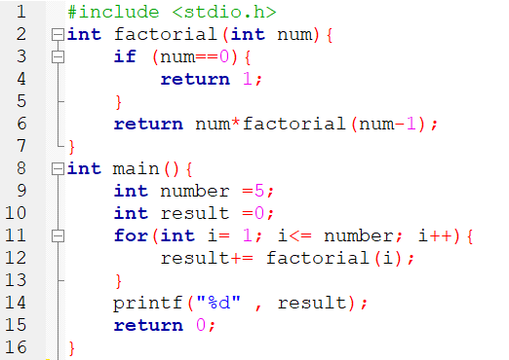
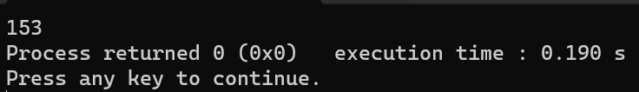
What is our project?
We made a simple C program that calculates the sum of factorials from 1 to 5, as it covers:
A recursive function
One conditional statement
One loop
Output:

Slide 3
So how does this program work and how does the assembly handle it?

Slide 4


High addresses
_main:
LFB13
%esp
%ebp
pushl %ebp
movl %esp,%ebp
pushing the value of the base stack pointer into the stack (decrement %esp by 4)
And then move the value of %esp to %ebp which sets the base pointer to point to the same location as %esp

Slide 5
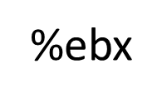
_main:
LFB13
pushl %esi
Decrement the stack pointer %esp by 4 and push the 32-bit %esi value into the stack
pushl %ebx
Decrement %esp by 4 and push %ebx value
andl $-16, %esp
-16 in hexadecimal is 0xfffffff0 -> %esp = %esp & 0xfffffff0
when anding with -16, we set the %esp register to the nearest multiple of 16 (stack alignment) which is sometimes required to improve performance for processes that operate more efficiently when data is aligned
Reference : https://stackoverflow.com/questions/23309863/why-does-gcc-produce-andl-16
High addresses
%ebp
%esi
%esp

Slide 6
_main:
LFB13
subl &16, %esp
%esp = %esp – 16, allocate 16 bytes in the stack (for local variables)
call ___main
This line refers to the ___main in the C library which eventually calls the main() function (internal procedure)
movl $1, %ebx
%ebx = 1, i is now stored in %ebx -> int i = 1
movl $0, %esi
%esi = 0, result in %esi -> int result = 0
jmp L7
Jump to L7
Reference : https://community.st.com/t5/stm32-mcus-products/main-in-startup-assembly/td-p/391658
High addresses
%ebp
%esi
16 bytes
%esp

Slide 7

Variable | Register
result | %esi
i | %ebx
_main:
L7:
cmpl $5, %ebx
i : 5, compare i with 5
jle L8
If less than or equal 5 (i<=5) jump to L8 which is the loop body
*L8 is explained later*
*We noticed that the compiler didn’t save the value of the variable number in any register and dealt with it as a runtime constant, the compiler optimized the code*
movl %esi, 4(%esp)
Move the content in the register %esi to the memory location of 4+%esp, 4 bytes from the stack pointer preparing it to be passed to printf
movl $LC0, (%esp)
Move the format string “%d” to the memory location pointed by %esp to be passed to printf, the “%d” means that it is expecting an integar argument
*LC0 is explained in details later*
call _printf
to print result
Reference : https://community.st.com/t5/stm32-mcus-products/main-in-startup-assembly/td-p/391658
High addresses
%ebp
%esi
8 bytes for other local variables
16 bytes
4 bytes for “%d”
%esp

Slide 8
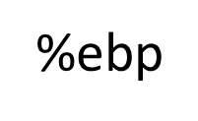

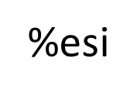

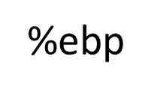
_main:
L7:
%ebp
movl $0, %eax
%eax = 0, moving the immediate value 0 to %eax for returning 0 at the end of the main function
leal -8(%ebp), %esp
%esp = %ebp – 8 (cleaning up the stack)
popl %ebx
Increment %esp by 4 and store the value popped at %ebx
popl %esi
popl %ebp
Same thing incrementing %esp by 4 each step to free the stack
ret
Returning the value in the register %eax which is 0 -> return 0
%esi
%esp
popl %ebx
popl %esi
popl %ebp
Freed!

Slide 9
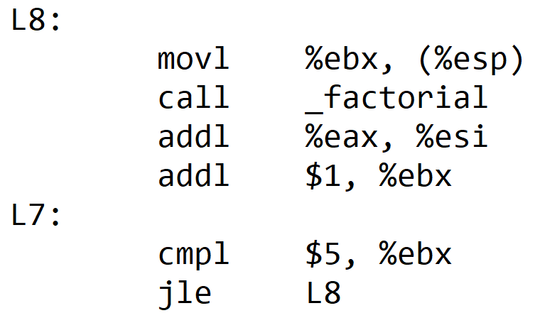
result | %esi
i | %ebx
_main:
L8:
movl %ebx, (%esp)
Move the value of %ebx (i) to the memory location of the stack pointer to use it by factorial function
call _factorial
Calling the function (explained later)
addl %eax, %esi
%esi = %esi + %eax -> result += factorial(i)
%esi stores the variable result and %eax is the return value of the function call factorial(i)
addl $1, %ebx
%ebx = %ebx + 1 -> i++
Then L8 body is completed it will go again to L7 and does comparison again i<=5 ?
if i<=5
goto L8
High addresses
%ebp
%esi
12 bytes
4 bytes
Value of i
%esp

Slide 10
_main:
LC0:
Before we jump to explaining factorial function, we explained LC0 because it is an important part of the program
*This is extra information
.ascii “%d\0”
Include these characters in the data section of the program
.text
Starts a new section, the “text” section is the section in object files that stores code
.global _main
Tells the assembler that this is a global symbol and should be visible to the linker because other object files will use it (declares it as a global symbol)
.def _main;.scl 2;.type 32; .endef
.def defines a symbol _main
.scl 2 set the storage class of the symbol to 2 (external symbol), external symbol means that is defined or used in another module
.type 32 indicates that _main is a function symbol (sets the type of the symbol), number 32 indicates a function
.endef: ends the definition
Reference: https://stackoverflow.com/questions/17794533/what-does-this-assembly-language-code-mean

Slide 11

_factorial:
LFB12:
pushl %ebx
Decrement %esp by 4 to push %ebx value
subl $24, %esp
%esp = %esp - 24
Decrement %esp by 24, allocating 24 bytes
movl 32(%esp), %ebx
Value of memory stored at (32 + %esp) is moved to %ebx which is the old value of i
This is setting the parameter of the function “num” to i
Now %ebx is representing num and took the value of i from the function call
->int num = i
testl %ebx, %ebx
testl ands the 2 arguments and sets the condition codes withour storing the result. Anding the same argument to see if it equals 0
because result of anding will only equal zero if %ebx value is 0
High addresses
%ebp
%esi
16 bytes
Value of i
24 bytes
%esp

Slide 12

_factorial:
LFB12:
jne L5
L5 is explained in the next slide
jne means jnz ~ZF, jumps if ZF equals 1
so if it equals zero:
movl $1, %eax
Move immediate value 1 to %eax to be returned
Then we goto L1
L1:
addl $24, %esp
Increments the stack pointer by 24 which means freeing the 24 allocated bytes
popl %ebx
Increment %esp by 4
ret
Returns the value stored in %eax which is 1
->return 1
High addresses
%ebp
%esi
16 bytes
Value of i

Slide 13
_factorial:
L5:
leal -1(%ebx), %eax
%eax = %ebx – 1
%ebx represents num so now %eax holds (num-1)
movl %eax,(%esp)
Move the value of %eax which is (num-1) to the memory location of %esp to be used by the factorial function
call _factorial
Now factorial will use the 4 bytes for num-1 as its new parameter
imull %ebx, %eax
%eax = %eax * %ebx
%eax represents the return value of factorial(num-1) and %eax represents num
Equivalent to num*factorial(num-1) in c code and then puts the value in %eax to be returned
jmp L1
Goto L1 to free the stack (as explained in previous slide) and return %eax value
High addresses
%ebp
%esi
16 bytes
Value of i
24 bytes
4 bytes for num-1
%esp

Slide 14
REFRENCES
https://stackoverflow.com/questions/23309863/why-does-gcc-produce-andl-16
https://community.st.com/t5/stm32-mcus-products/main-in-startup-assembly/td-p/391658
https://stackoverflow.com/questions/17794533/what-does-this-assembly-language-code-mean

Slide 15
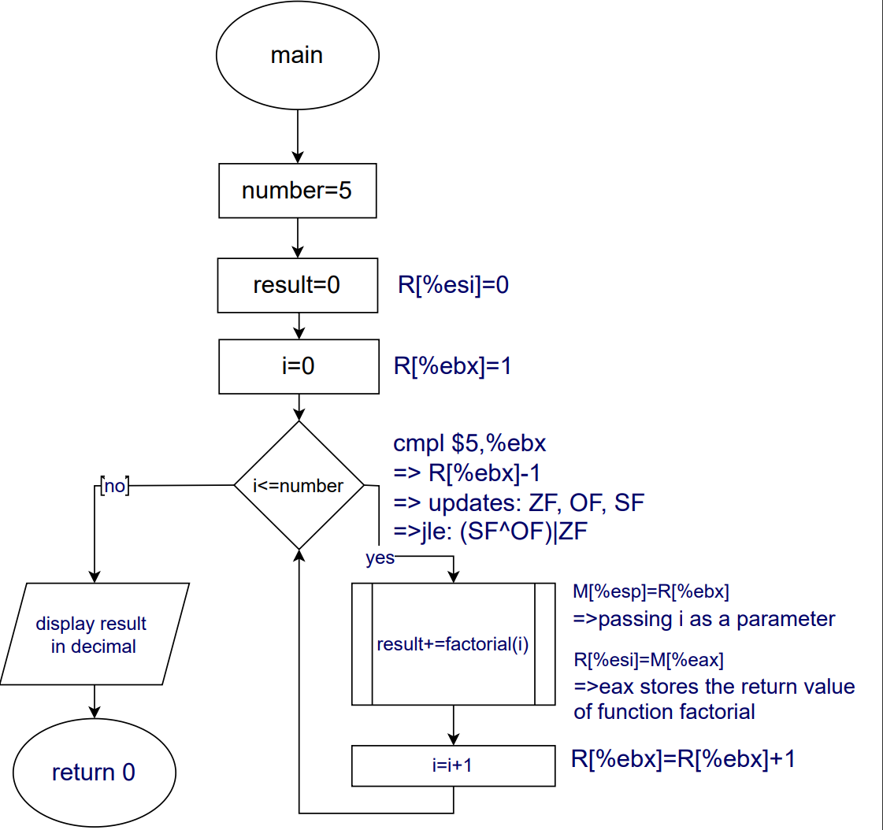
Let’s sum it up using flowcharts.

Slide 16
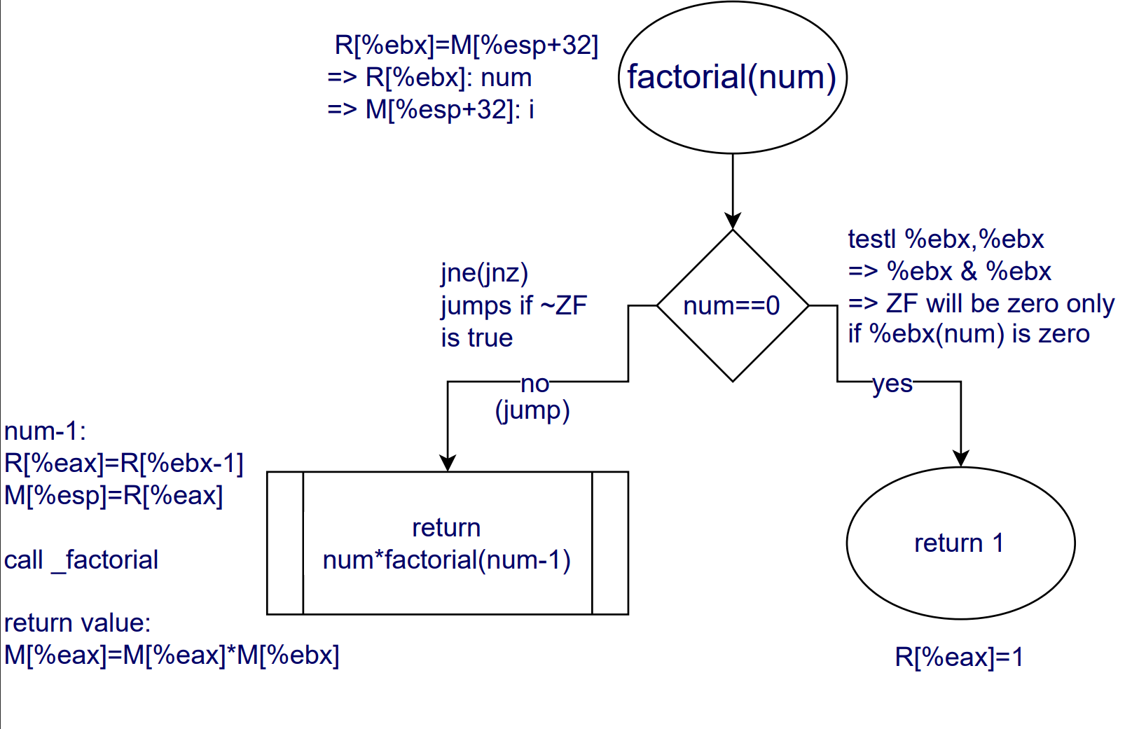
The factorial
part

Slide 17
Importance of computer architecture

Slide 18
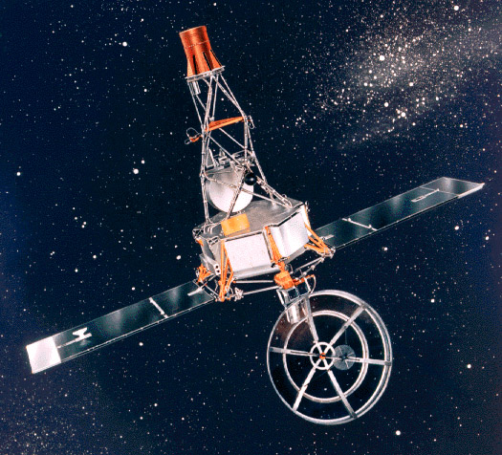
1-Fetal Error:
What was Mariner 1?
America's first attempt to explore Venus up close was lost to a software glitch. Investigators found a typo caused a fault in the launch vehicle's guidance software. The spacecraft and booster were destroyed shortly after launch for safety.
The failure was traced to a guidance antenna on the Atlas. Also, a software error, the omission of an overbar for the symbol R for radius (R instead of R̅) in an equation, caused the program to not respond as planned. It should be noted the omission was not a hyphen, as sometimes erroneously reported.
This highlights the importance of learning data and characters representation in computers, which can found in the computer architecture course.

Slide 19
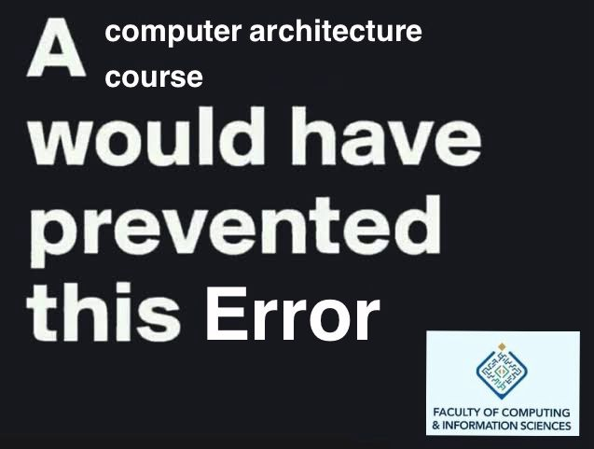

Slide 20
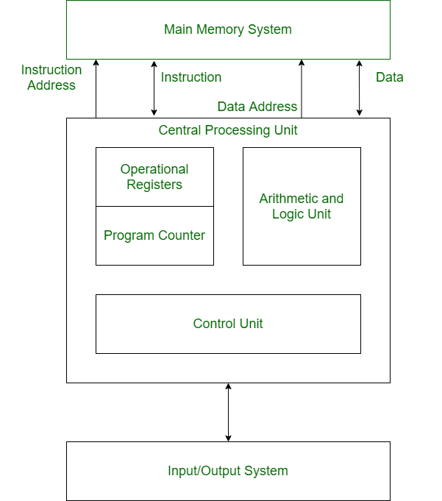
2-Harvard architecture:
The Harvard architecture is a computer architecture with separate storage and signal pathways for instructions and data. It is often contrasted with the von Neumann architecture, where program instructions and data share the same memory and pathways.
Famous usage: Most current ARM based processors are based on Harvard Architecture, such as Apple iPhones and Macs processors, the A and M series. The famous Qualcomm Snapdragon chip used in most high end android phones. ARM based processors are famously known for their huge power efficiency which is important for portable computers.

Slide 21
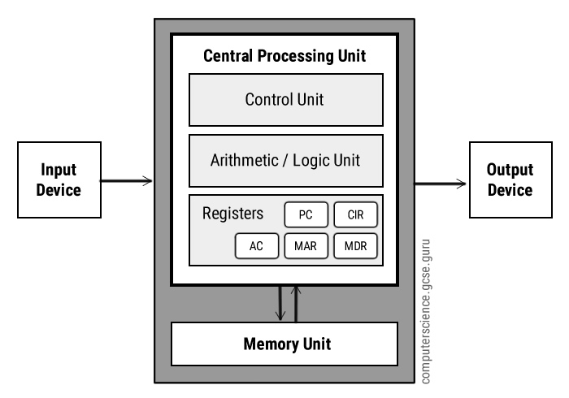
3-Von Neumann Architecture:
The von Neumann architecture—also known as the von Neumann model or Princeton architecture—is a computer architecture based on a 1945 description by John von Neumann, and by others, in the First Draft of a Report on the EDVAC.[1]

Slide 22

4-Computer Architecture and Machine Learning:
The end of Moore's Law and Dennard scaling hinders general-purpose program improvement. Machine learning, rooted in low-precision linear algebra, provides an alternative, transforming fields like vision and language understanding. Specific architectures, such as Google's TPU, enhance ML's applicability. Collaborative efforts between ML experts and computer architects are essential to meet the growing demand for ML computing.

Slide 23

5-Intel Pentium FDIV Bug:
The Pentium FDIV bug, discovered in 1994 by Professor Thomas R. Nicely, was a hardware flaw affecting the floating-point unit (FPU) of early Intel Pentium processors. This bug caused incorrect binary floating-point results when dividing numbers due to missing entries in the FPU's lookup table. While the bug was rarely encountered by most users (estimated at 1 in 9 billion floating-point divides with random parameters), both the flaw and Intel's initial response faced heavy criticism from the tech community. Intel ultimately recalled the defective processors in December 1994 and incurred a pre-tax charge of $475 million in January 1995 for the replacement program.

Slide 24
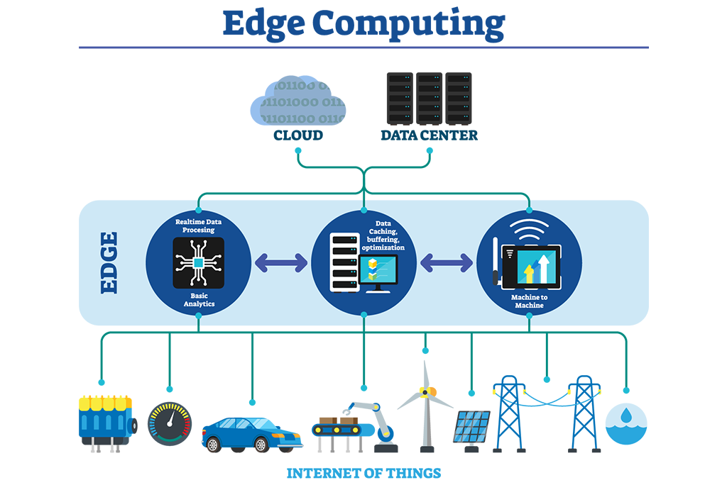
6-Egde computing in iot:
Internet of Things applications often work as monitoring systems that collect and analyze data to trigger informed actions. IoT apps might process data daily, hourly, or in respond to external triggers. Edge computing benefits IoT by moving computing processes closer to the device, reducing network traffic and latency to enable real-time insights.
IoT devices often send small data packets back to a central management platform for analysis. This system works well for some applications, but the expected growth of IoT means that future networks will be overburdened with devices. Edge computing optimizes bandwidth and only sends long-term storage data to the central platform, not all data.

Slide 25
REFRENCES
https://science.nasa.gov/mission/mariner-1/
https://www.sciencedirect.com/topics/engineering/harvard-architecture
https://en.wikipedia.org/wiki/Harvard_architecture
https://en.wikipedia.org/wiki/Qualcomm_Snapdragon
https://www.sciencedirect.com/topics/computer-science/von-neumann-architecture#:~:text=The “classical” von Neumann architecture,storing both instructions and data.
https://doi.org/10.1109/MM.2018.112130030
https://superfri.susu.ru/index.php/superfri/article/view/165
https://handwiki.org/wiki/Software:Pentium_FDIV_bug
https://itwire.com/business-it-news/security/when-f00f-bug-hit-20-years-ago,-intel-reacted-the-same-way.html
https://www.run.ai/guides/edge-computing/edge-computing-in-iot

Slide 26
Contributions
Mapping between c and assembly:
Ahmed Sameh 22-101198 / Shady Ali 22-101195 / Laila Khaled 22-101078
Tracing:
Nour Hany 22-101068 / Yasmine Mohammed 22-101174

